Slide 1
Rollins College Odyssey
Rolly Colly Extravaganza

Slide 2

Rolly Odyssey
Welcome to Rollins College Mini-Games Odyssey! Dive into the vibrant world of Rollins College, where every corner of the campus brings a new challenge, and every mini-game you conquer brings you closer to becoming the ultimate Rollins champion.

Slide 3
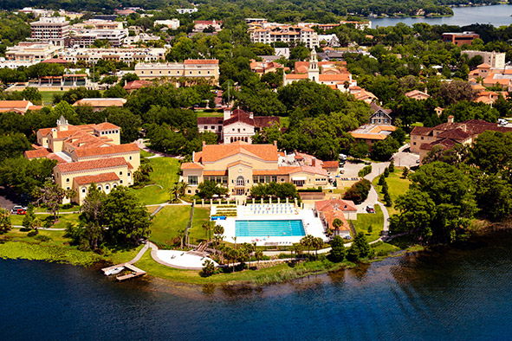
Play against a different professor at each game
Play all the games to unlock the final boss

Slide 4
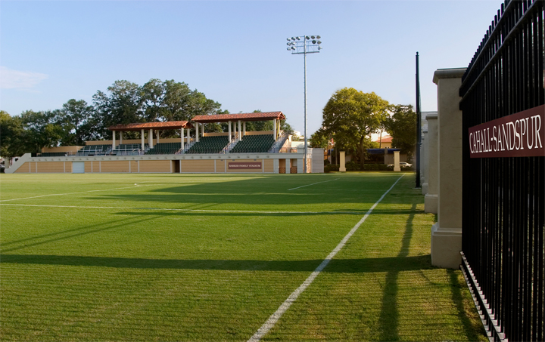
Game 1 : Field
Football game
Controls: Arrows and Space

Slide 5
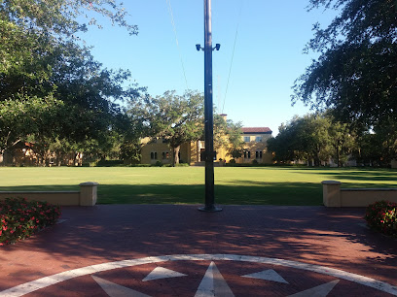
Game 2: Mills lawn
Racing game
Controls: Arrows and Space

Slide 6
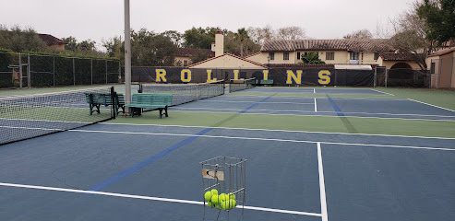
Game 3: Tennis Courts
Ping Pong game
Controls: WASD and Arrows

Slide 7
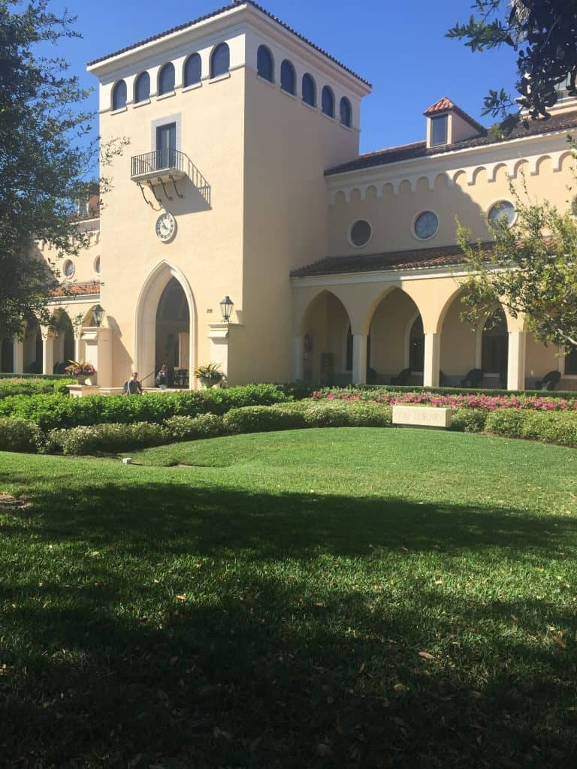
Game 4: Library
Connect 4 game
Controls: Arrows and Space

Slide 8
THANK YOU FROM ERIN AND THE LATINOS :)

